Slide 1
Introduction to Statistics for Ecology and Evolutionary Biology Bayesian Basics Week 04 17 February 2019

Slide 2
In-Class Activity
Notes:
Parameters are characteristics of a statistical population or a statistical model we wish to estimate
For instance, the mean mass of adult male housecats and the mean mass of adult male lions are two parameters we might be interested in estimating
What do we know about these two parameter a priori? In other words, what might we know about these parameters before seeing any data?
https://c.pxhere.com/photos/e6/e1/cat_laying_pet_animal_domestic_animal_feline_cute_mammal-1125748.jpg!d
https://upload.wikimedia.org/wikipedia/commons/thumb/7/73/Lion_waiting_in_Namibia.jpg/1200px-Lion_waiting_in_Namibia.jpg

Slide 3
Thomas Bayes
Notes:
English statistician and Presbyterian minister (1701-1761)

Slide 4
Notes:
The Theory That Would Not Die by Sharon McGrayne

Slide 5
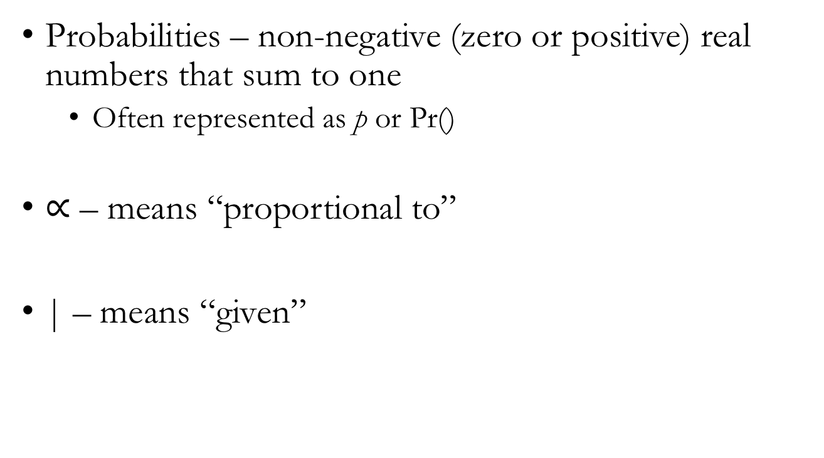
Initial Definitions and Notation
Probabilities – non-negative (zero or positive) real numbers that sum to one
Often represented as p or Pr()
$∝$ – means “proportional to”
| – means “given”

Slide 6
Initial Definitions and Notation
If we want to know the probability of both of two independent events, A and B, occurring:
Pr(A and B) = Pr(A ∩ B) = Pr(A) * Pr(B)
If we want to know the probability of either of two mutually exclusive events, A and B, occurring:
Pr(A or B) = Pr(A ∪ B) = Pr(A) + Pr(B)
Notes:
∩ - the intersection of two events
∪ - the union of two events

Slide 7
Summary of Bayesian Inference
We make formal conjectures about the state of the world
(assign prior probability distributions to parameters)
and modify this information in the light of evidence
(data)
to produce updated inference
(posterior probability distributions)
Notes:
This process of Bayesian learning is also called Bayesian updating

Slide 8
Notes:
Explain globe-tossing data example from the text
The parameter of interest is the proportion of the globe that is covered in water
The data we collect is whether land or water is recorded underneath our finger with each globe toss
https://www.waypointgeographic.com/p/little-adventurer-globe/?gclid=EAIaIQobChMIqe3Gw_LW5wIVFJSzCh28DgpQEAQYASABEgJQFvD_BwE

Slide 9
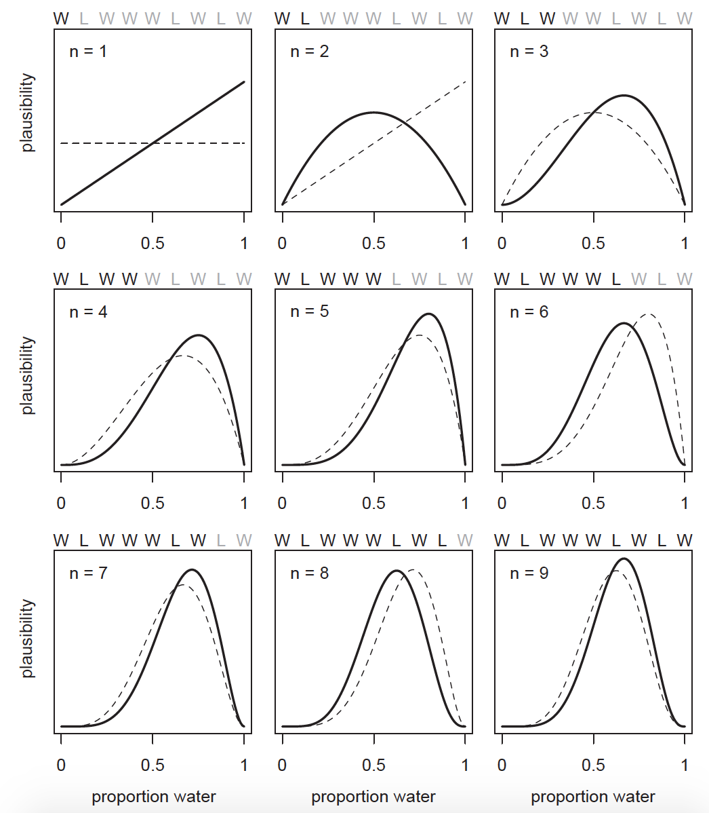
Notes:
Key points:
Updating plausibility in the light of evidence from the data. Observed Ws move the curve to the right, observed Ls move it to the left.
However, parameter values quite far from the “true” value can remain plausible
Maximum relative plausibility increases with data
Highlights the importance of sample size

Slide 10
Formalizing Bayesian Inference
Likelihood – mathematical formula that specifies the plausibility of the data
Parameters – quantities we wish to estimate from the data
Prior – initial set of plausibilities for a parameter
Priors with no information: “flat”, “naïve”, or “un-informative”
Priors with some information: “regularizing” or “weakly informative”
Notes:
Show dbinom() function in R script to emphasize the fact that the likelihood function is showing us the relative plausibility of different outcomes

Slide 11
Formalizing Bayesian Inference
Once a likelihood, parameter(s), and prior(s) have been specified, you expose them to data to generate inference
The resulting inference is represented by the posterior
Posterior distribution – the relative plausibility of different parameter values, given your prior and the data observed

Slide 12
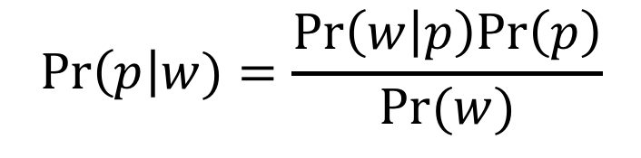

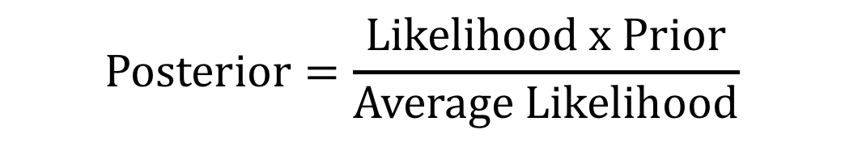
Bayes’ Theorem
$$\operatorname{Pr}\left(p\right|w)=\frac{Pr\left(w | p\right)Pr\left(p\right)}{Pr(w)}$$
$$\operatorname{Posterior}{=\frac{Likelihood x Prior}{Average Likelihood}}$$
$$\operatorname{Posterior}{∝}Likelihood x Prior$$
Notes:
“The key lesson is that the posterior is proportional to the product of the prior and the likelihood.”

Slide 13
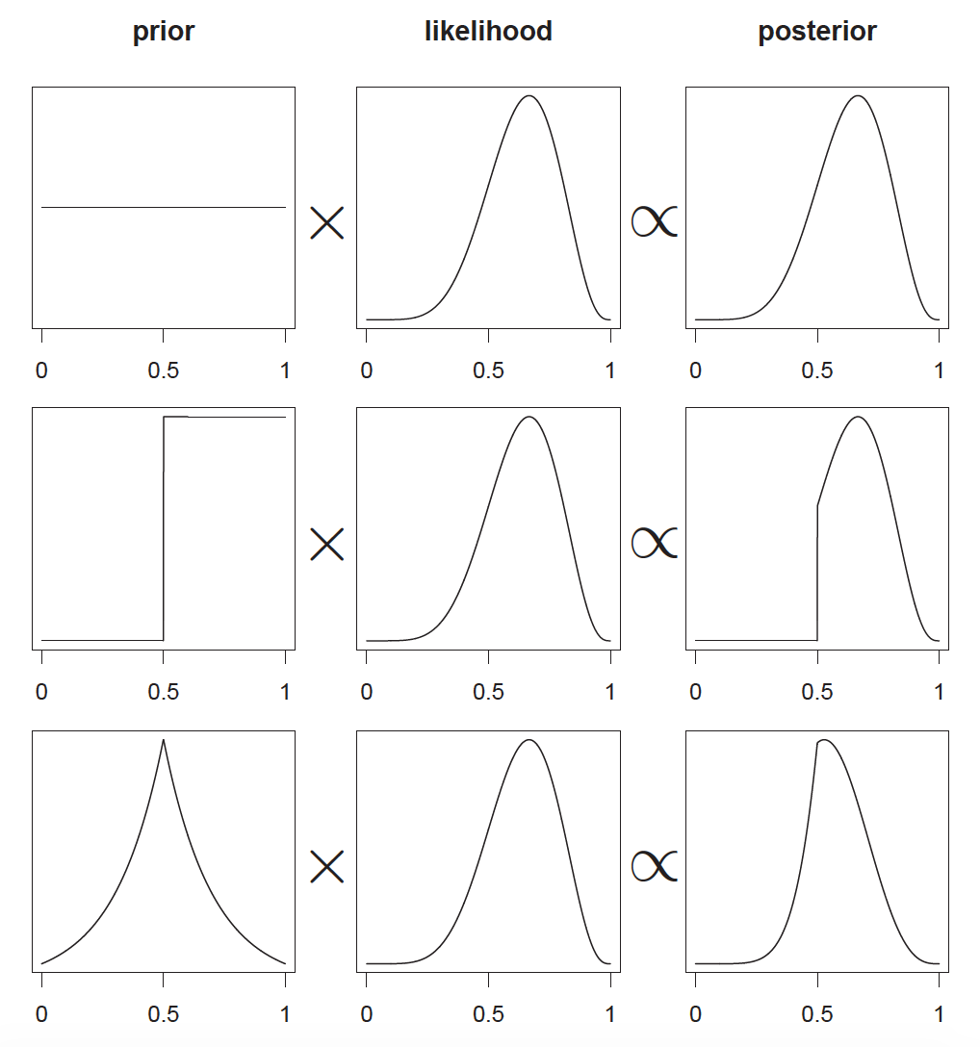
Notes:
These graphics highlight that the posterior is the result of a multiplicative interaction between the prior and the likelihood

Slide 14
Three Numerical Methods for Bayesian Inference
1) Grid approximation
This week and next week using standard R functionality
2) Quadratic approximation
Most of the rest of the semester using rethinking package functions
3) Markov chain Monte Carlo (MCMC)
A little bit further into the semester using rethinking package functions that call Stan
Notes:
Go to lecture code script to show the process of grid approximation for posterior estimation

Slide 15
Important Caveats
Posterior distributions are a reflection of model’s certainty about a parameter given the assumptions built into the model
No guarantee the model is a good one
“All models are wrong, but some are useful”

